Slide 1
MOOD-TUNES:Music Recommendations Based on People's Facial Expressions
Rubaiyet Arefin Oishi-1921585042
Md. Jisan Ahmed - 2011135042
Sajadul Islam Akash - 1831722642
Akil Hossain Prottoy- 1931795642

Slide 2
Overview
Motivation
Objective
Literature review
System Design
Result
Work distribution
Conclusion

Slide 3
Motivation
Facial expressions projects a person's emotional state, and music has the power to evoke and amplify those emotions.
By analyzing the facial expressions, a music recommendation system could understand the user's current emotional state and recommend songs.
This creates a stronger emotional connection between the user and the music, leading to a more engaging and satisfying experience.
Our system will suggest songs that are more suited to the user's current mood and emotional needs.

Slide 4
Objective
Create a user-friendly experience, where users can provide facial expressions as input, receive relevant recommendations, and interact with the system effortlessly.
Design the system with intuitive interfaces and robust performance to ensure a positive user experience.
Perform real-time analysis of facial expressions to provide instantaneous recommendations.
Capture and respond to the user's changing emotional state in real-time, ensuring that the recommended music is relevant and timely.

Slide 5
Literature Review
Yusuf Yaslan et al. proposed an emotion-based music recommendation system that learns the user's emotion from signals obtained through wearable computing devices.
“David Matsumoto” and “Sung Hwang” published a paper titled “Reading facial expressions of emotion” with the validation accuracy 92.Used model in DBN.
“Akshobhya Rao” and “Fathima Rameesha” published a paper titled Emotion Based Music Player (Emotify). with the validation accuracy 77.Used model in CNN.
“R Ram Rohan”,“Ramya Ramanathan”,“Rajat Gupta” and “Radha Kumaran” also published An Intelligent Music Player Based on Emotion Recognition with the validation accuracy 84.Used model in CNN.

Slide 6
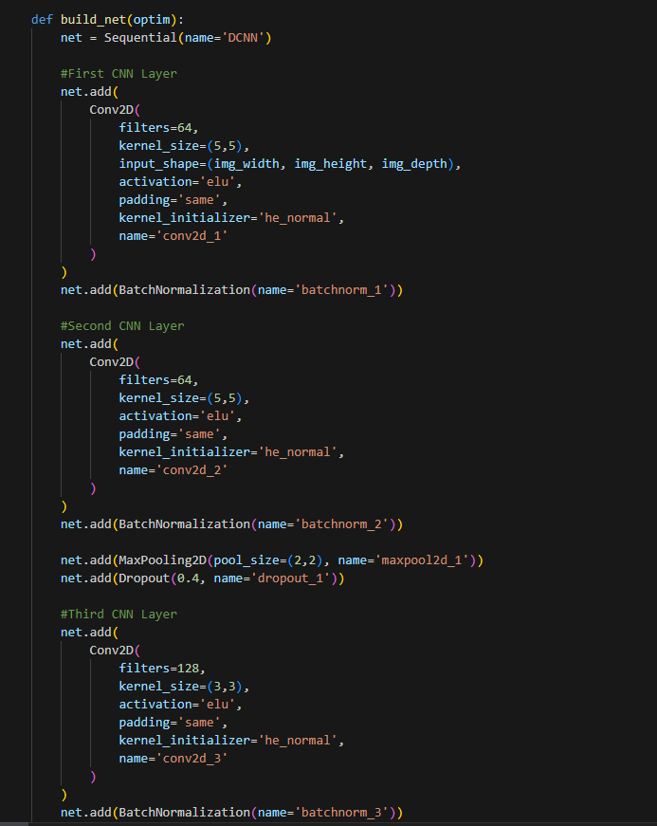
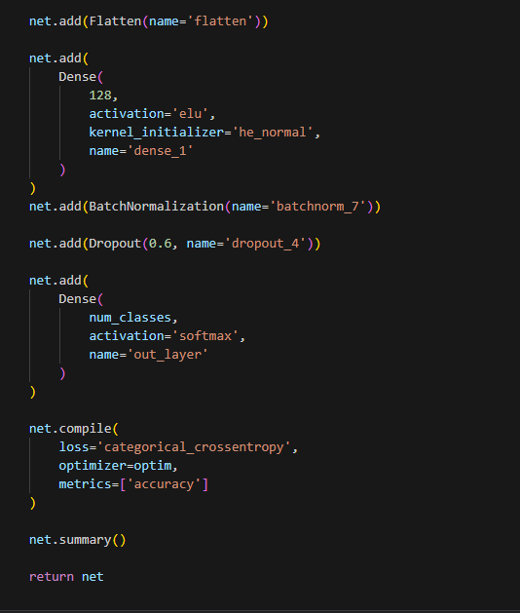
Result & Analysis (Model Building 01)

Slide 7
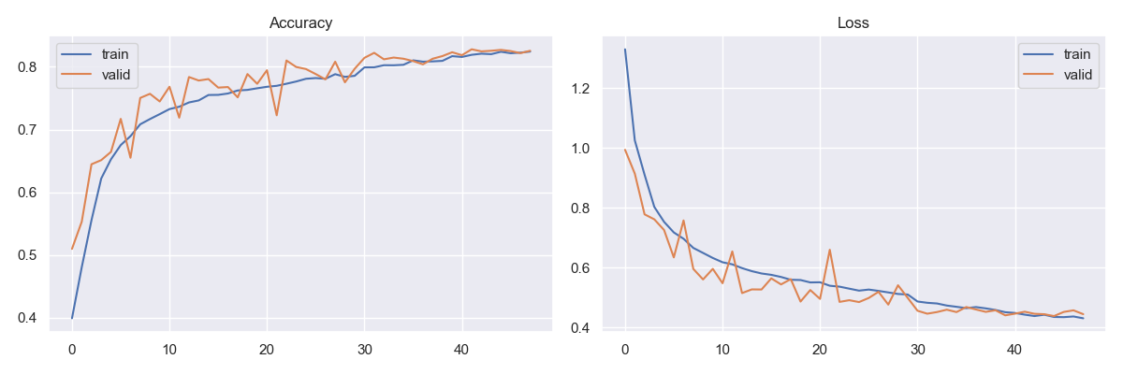
Result(Accuracy & Loss M1)

Slide 8
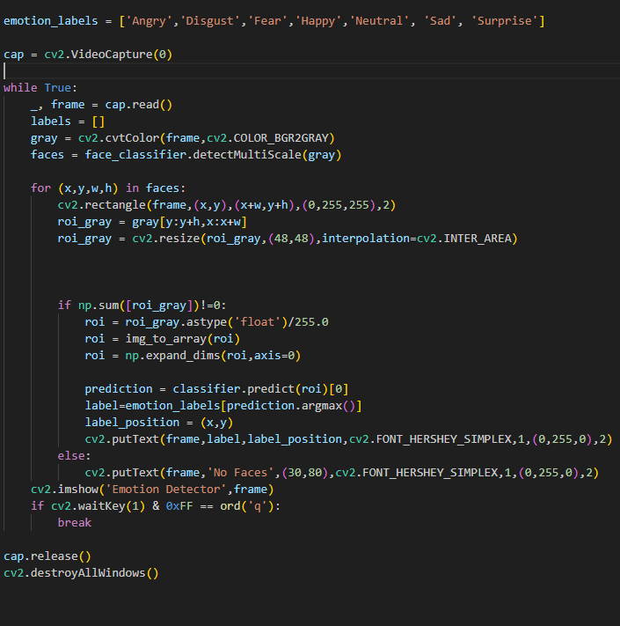
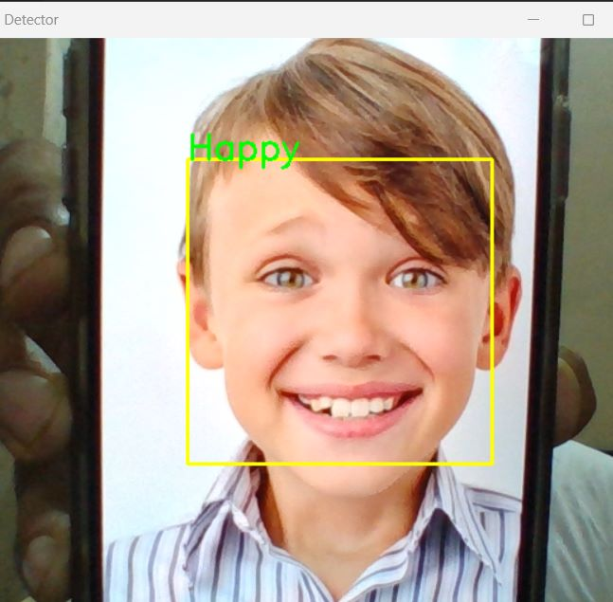
Result (Live Cam Testing M1)

Slide 9
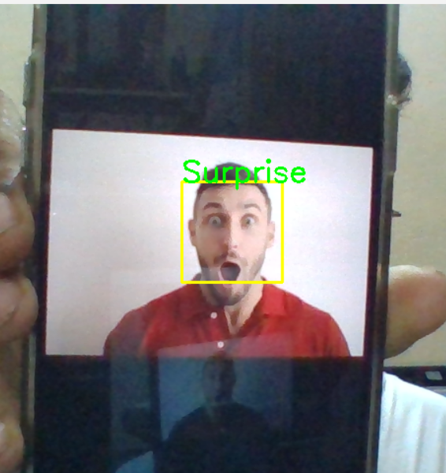
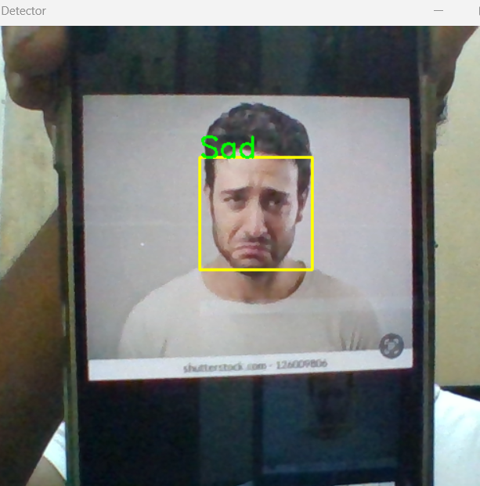
Result (Live Cam Testing M2)

Slide 10
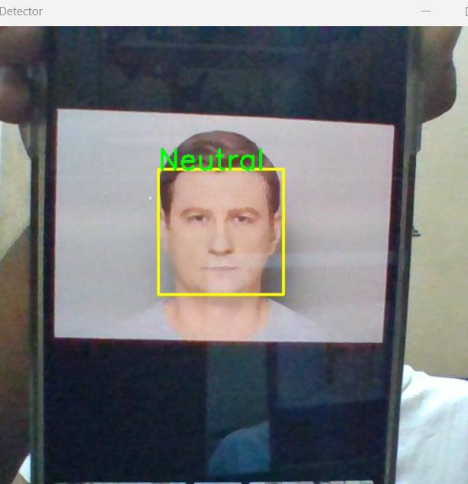
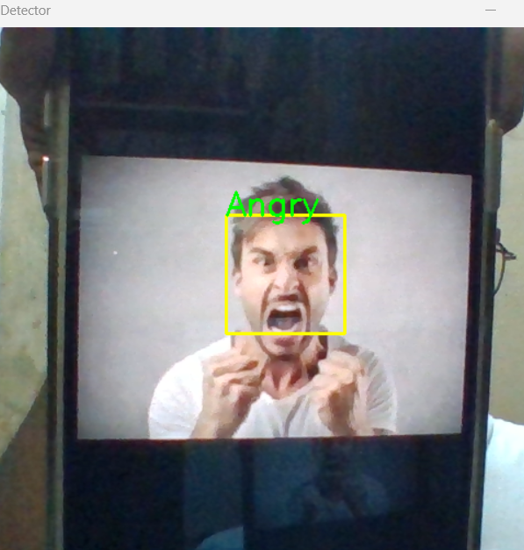
Result (Live Cam Testing M3)

Slide 11
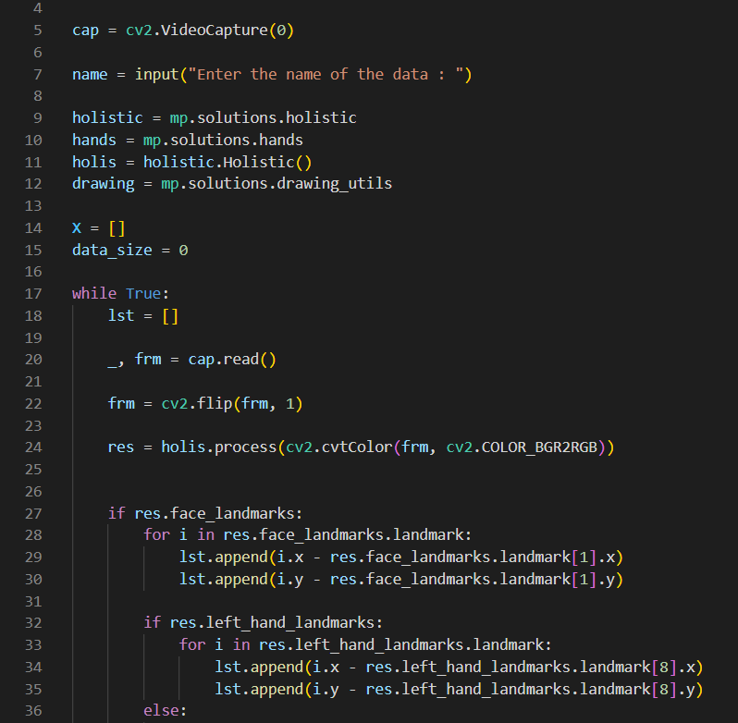
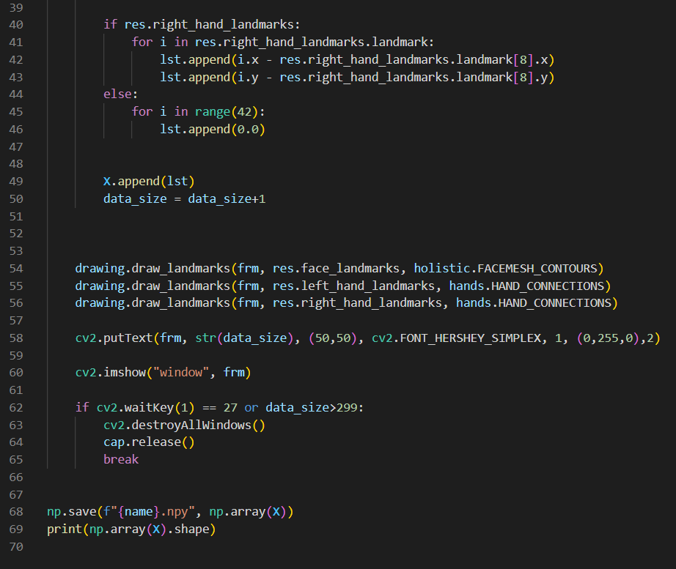
Model 02: Data Collection (499B Starts)

Slide 12
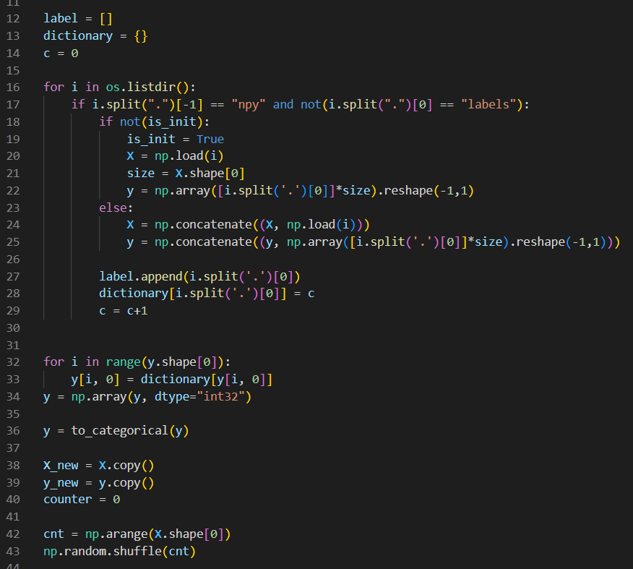
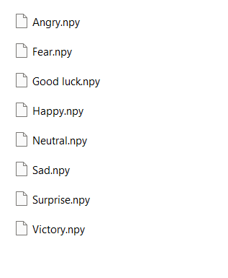
Model 02: Data Training

Slide 13
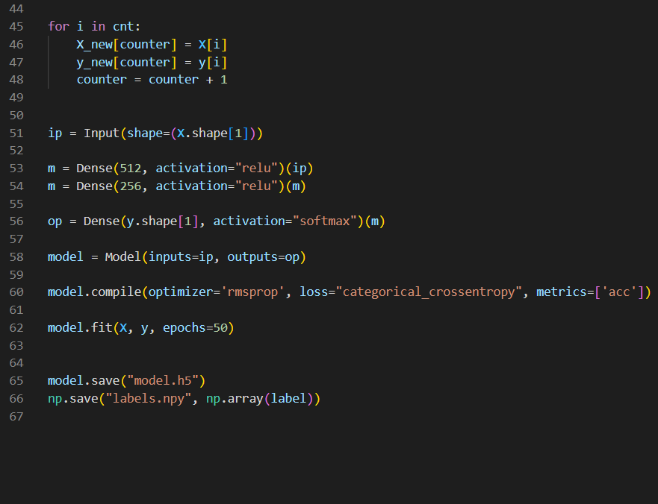
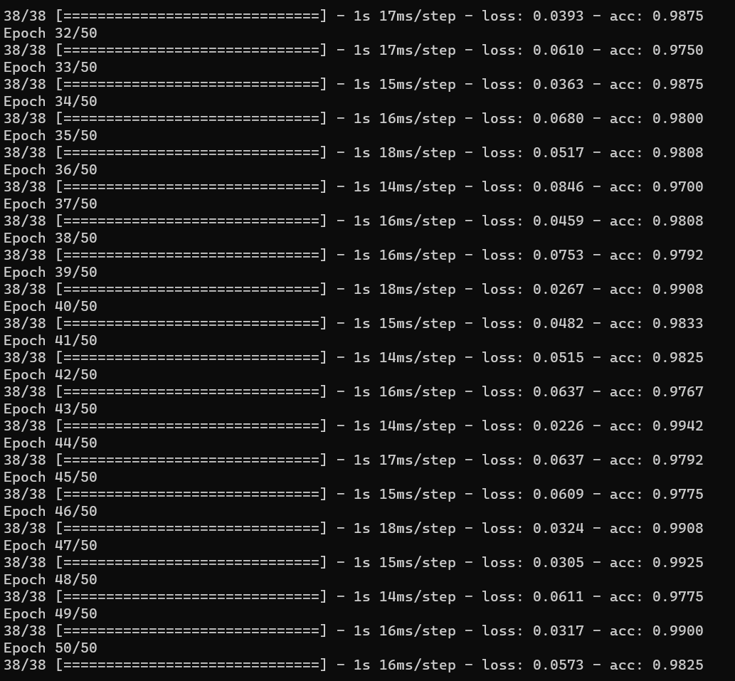
Model 02: Model Building &Accuracy

Slide 14
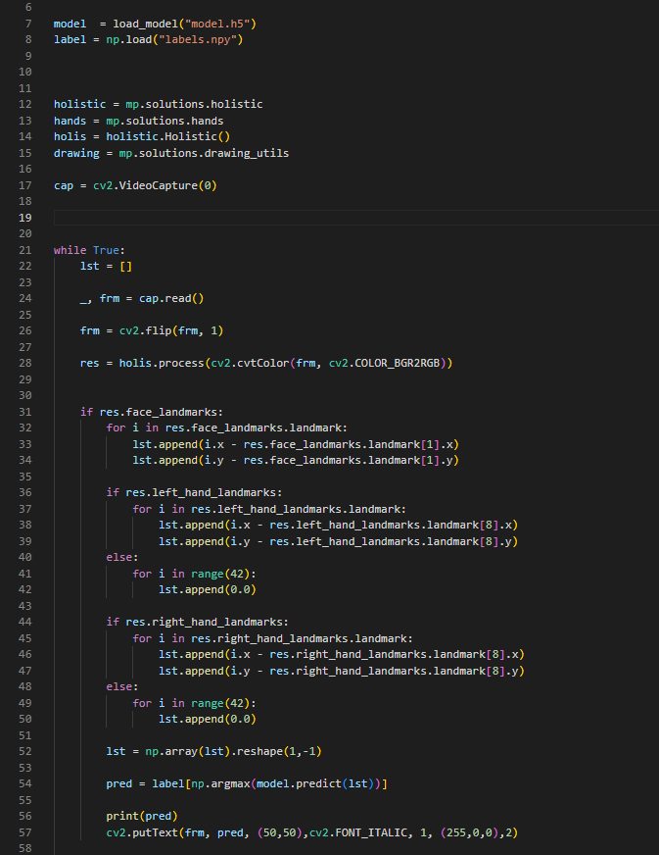
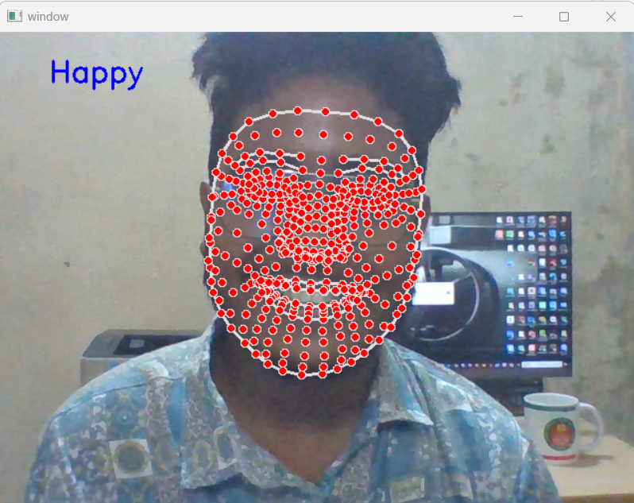
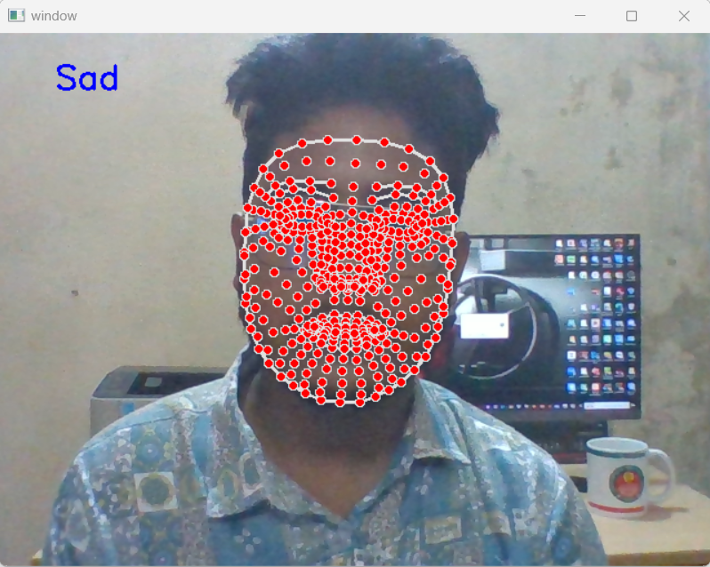
Model 02: Live Cam Testing

Slide 15
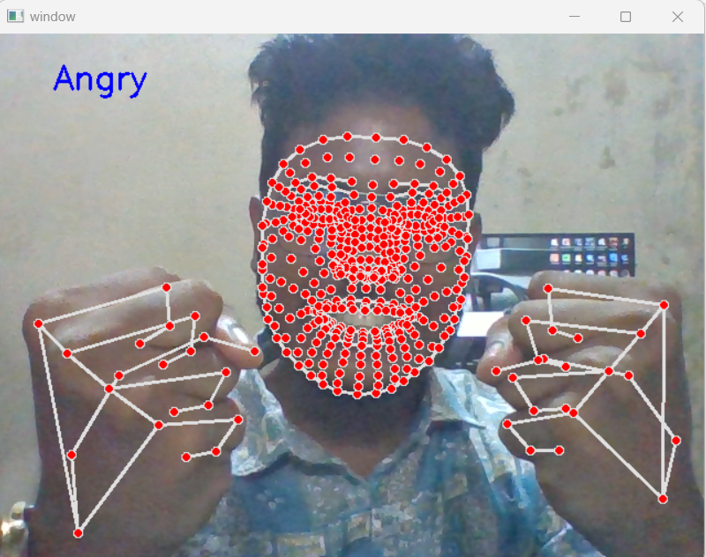
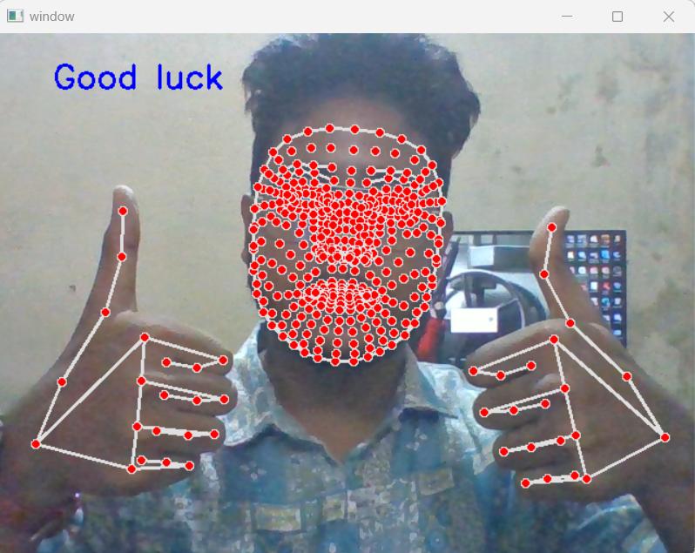
Model 02: Live Cam Testing

Slide 16
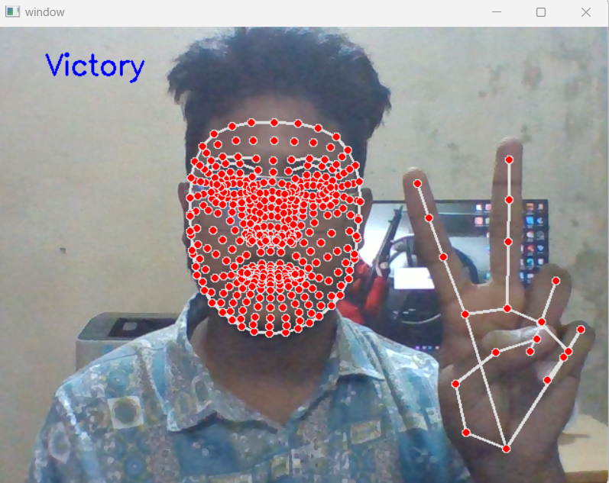
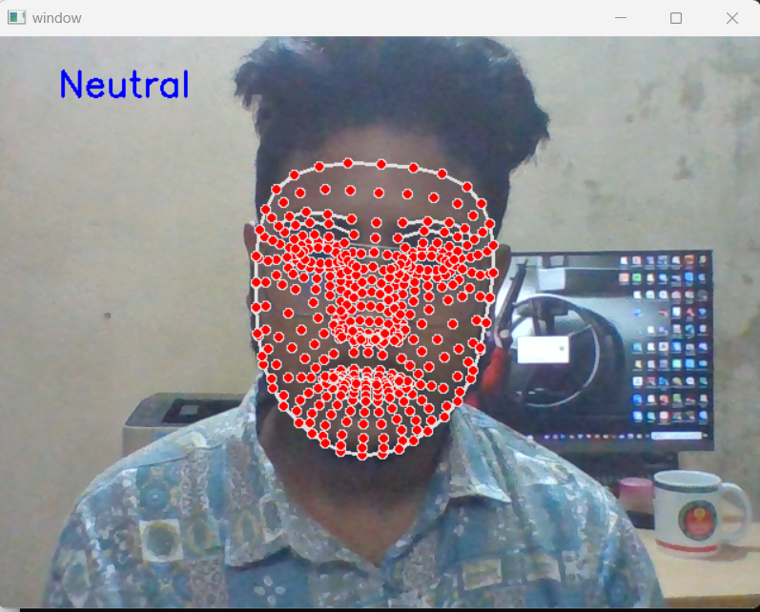
Model 02: Live Cam Testing

Slide 17
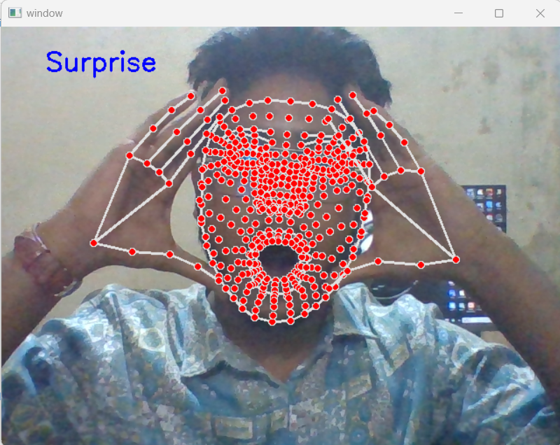
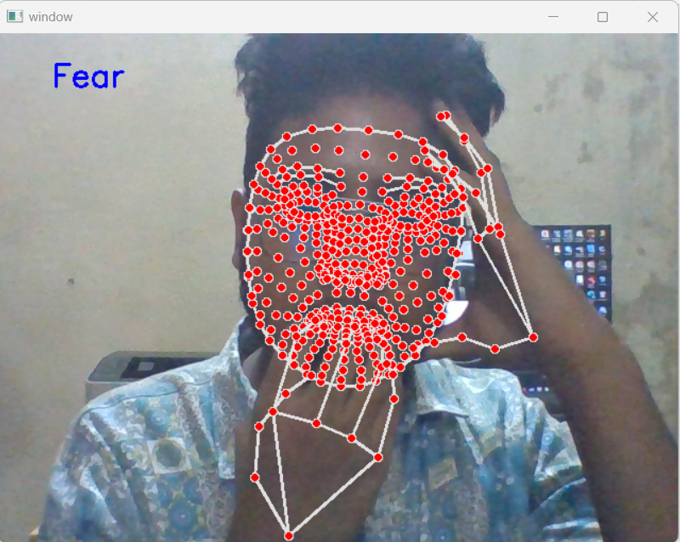
Model 02: Live Cam Testing

Slide 18
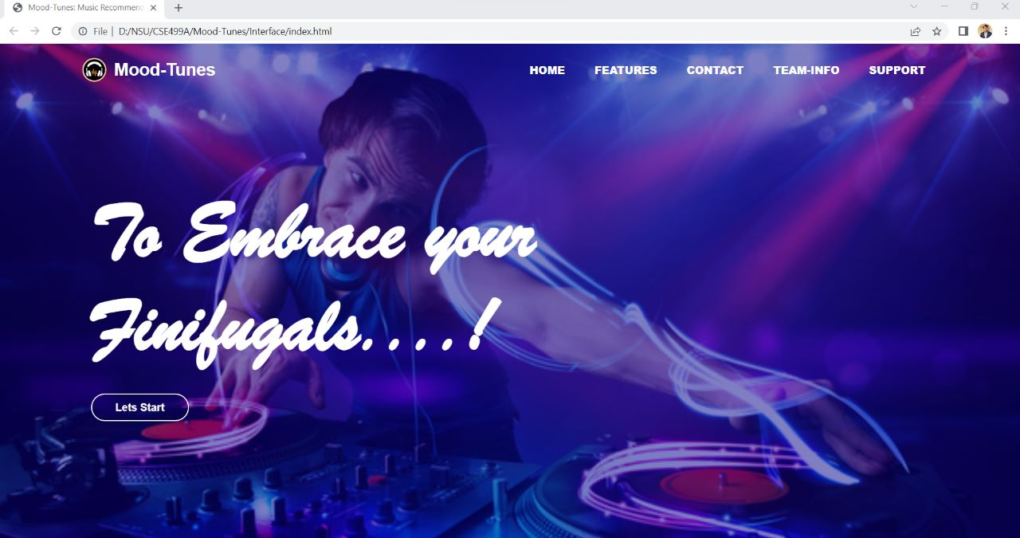
Result (User Interface)

Slide 19
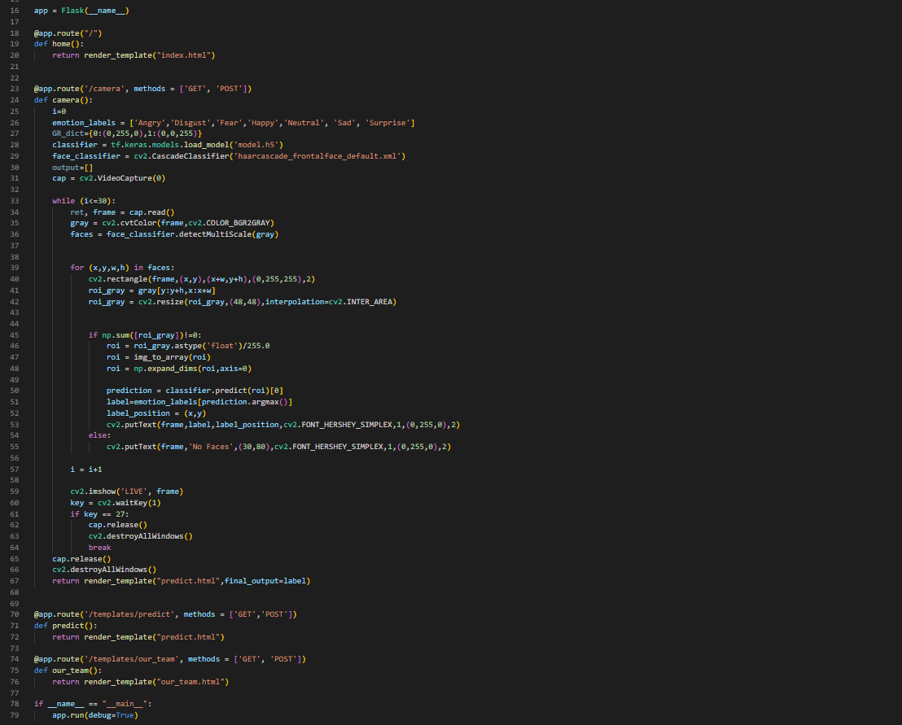
Implementation in Webapp(using Flask):

Slide 20
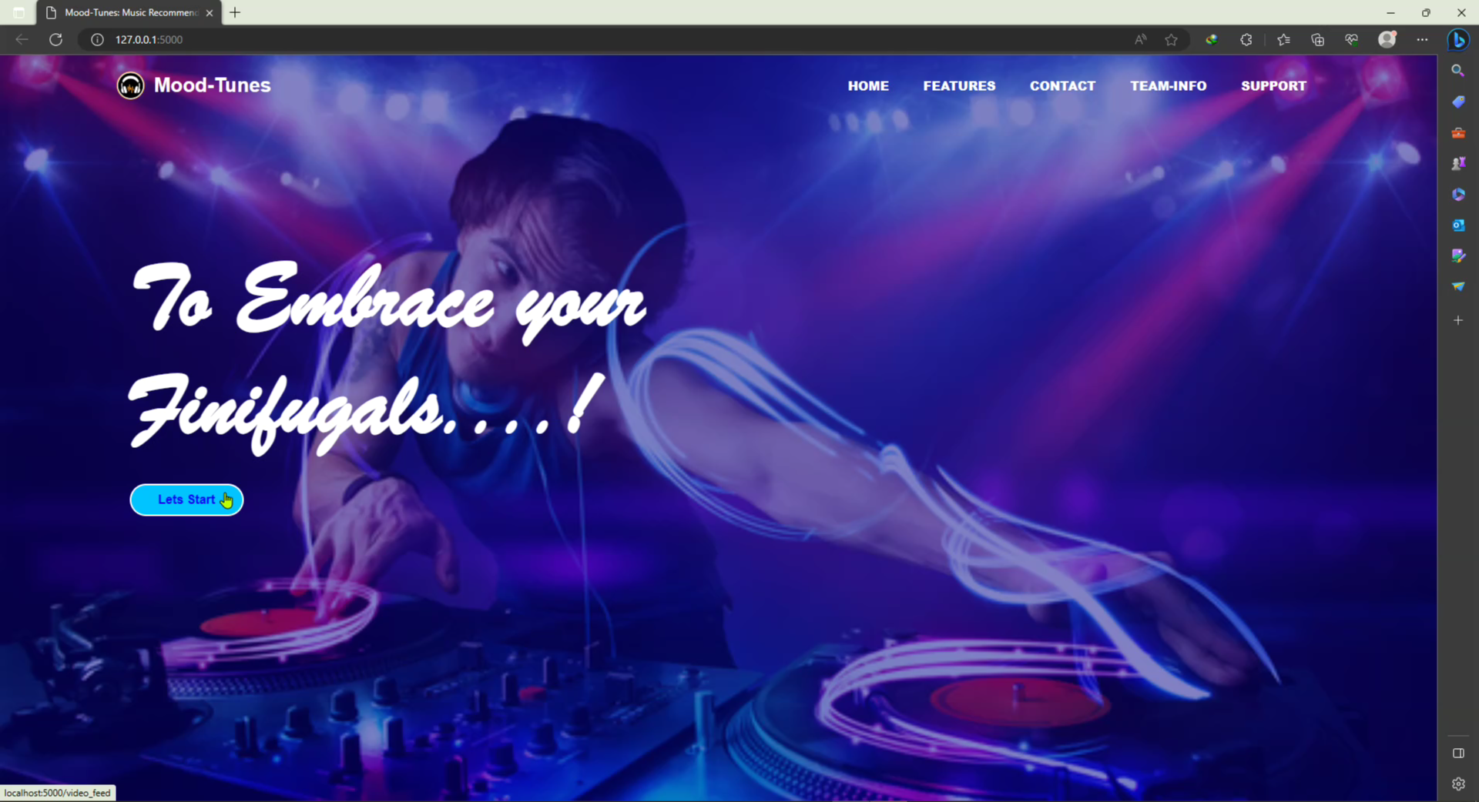
Implementation:(continued)

Slide 21
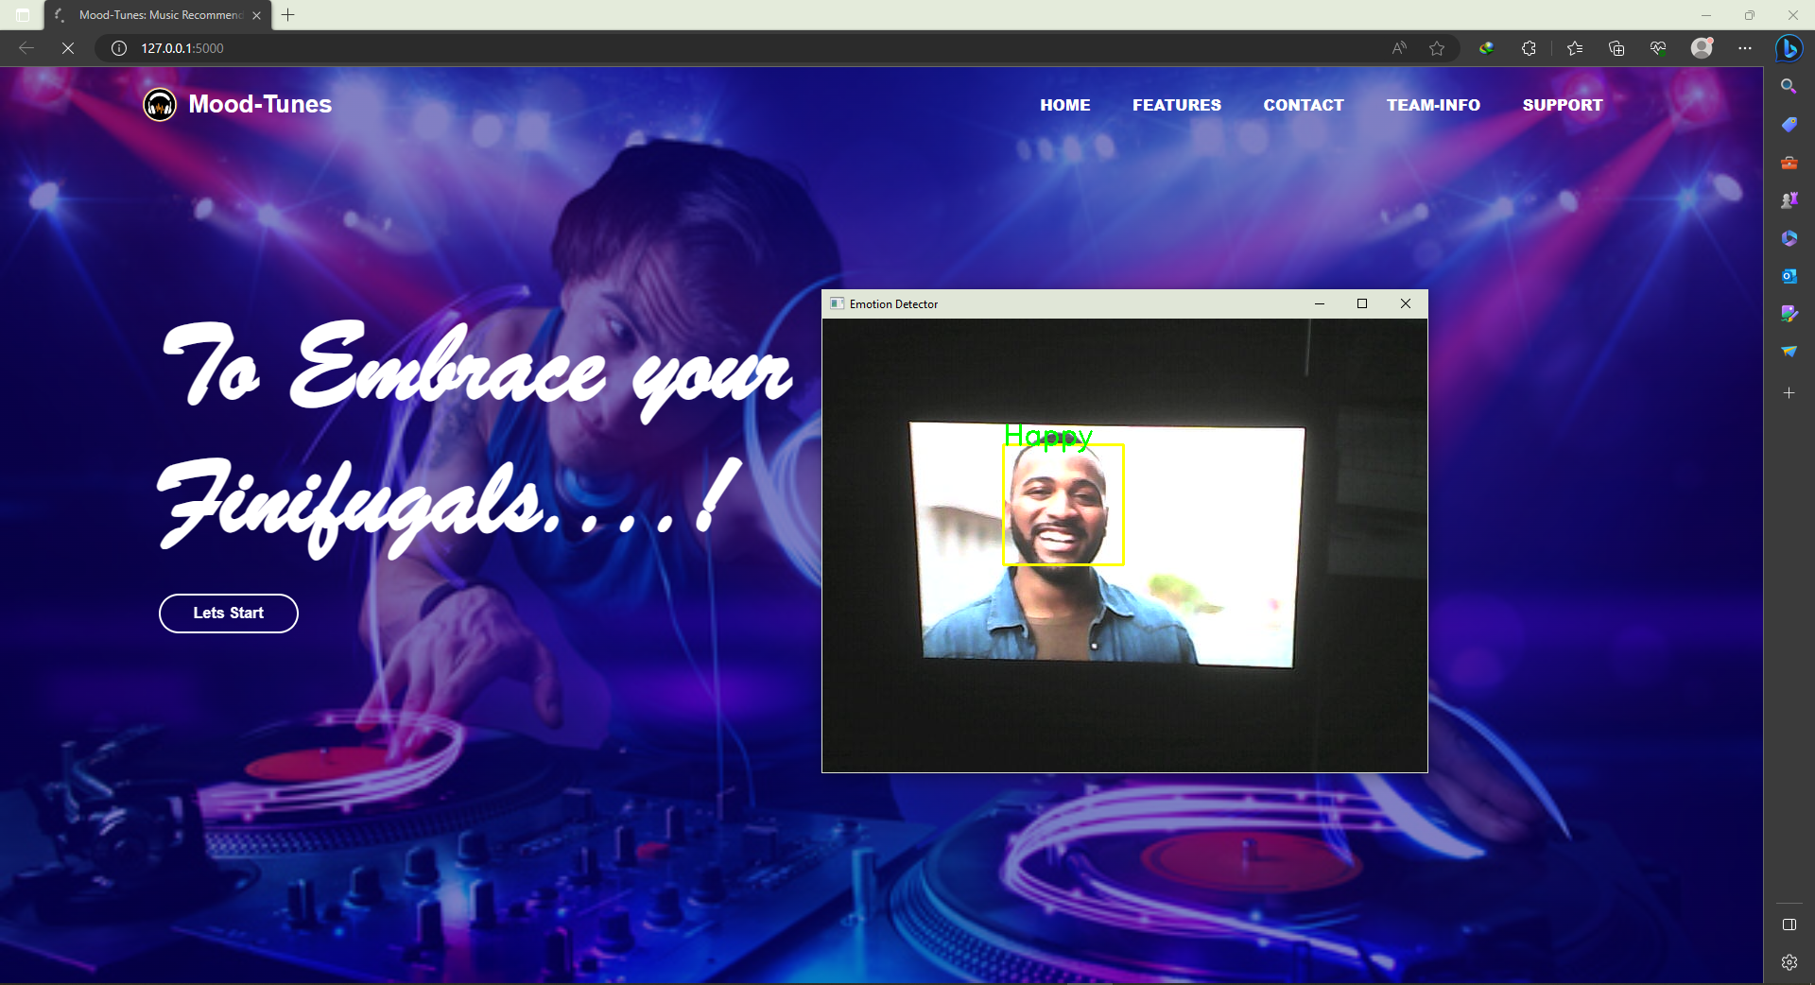
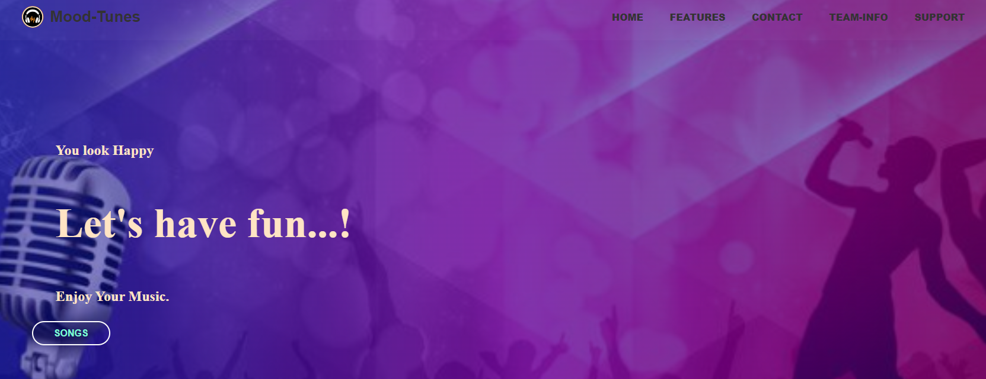
Implementation:(continued)

Slide 22
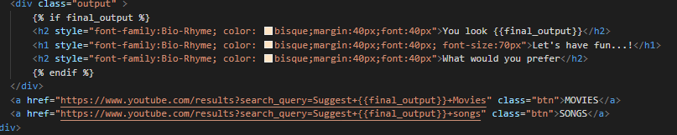
Result (Music Searching)
First get the emotion value as final_output
Will generate a web link.
And search the music base on emotion detected.

Slide 23
Future Work
Deploy Model 02 in webapp with the previous one.
Try other Models also.
Advance user interfaces.
Fully worked web project.

Slide 24
Reference :
[1] Ramya Ramanathan, Radha Kumaran, Ram Rohan R, Rajat Gupta, and Vishalakshi Prabhu, an intelligent music player based on emotion recognition, 2nd IEEE International Conference on Computational Systems and Information Technology for Sustainable Solutions 2017.
https://doi.org/10.1109/CSITSS.2017.8447743
[2] Shlok Gilda, Husain Zafar, Chintan Soni, Kshitija Waghurdekar, Smart music player integrating facial emotion recognition and music mood recommendation, Department of Computer Engineering, Pune Institute of Computer Technology, Pune, India, (IEEE),2017.
https://doi.org/10.1109/WiSPNET.2017.8299738
[3] Deger Ayata, Yusuf Yaslan, and Mustafa E. Kamasak, Emotion-based music recommendation system using wearable physiological sensors, IEEE transactions on consumer electronics, vol. 14, no. 8, May 2018.https://doi.org/10.1109/TCE.2018.2844736
[4] Ahlam Alrihail, Alaa Alsaedi, Kholood Albalawi, Liyakathunisa Syed, Music recommender system for users based on emotion detection through facial features, Department of Computer Science Taibah University, (DeSE), 2019.
https://doi.org/10.1109/DeSE.2019.00188
[5] Research Prediction Competition, Challenges in representation learning: facial expression recognition challenges, Learn facial expression from an image, (KAGGLE).
[6] Preema J.S, Rajashree, Sahana M, Savitri H, Review on facial expression-based music player, International Journal of Engineering Research & Technology (IJERT), ISSN-2278-0181, Volume 6, Issue 15, 2018.

Slide 25


